Slide 1
Notes:
Good morning everyone, my name is Lucía and I want to present you our Smart urban transport solution: ubibus
So Let's take a look at a key moment in public transport: the wait at the bus stop

Slide 2

Pablo Aparicio Martín Lucía Moreno Yance María Fernanda Rojas Bandres
Notes:
Good morning everyone, my name is Lucía and I want to present you our Smart urban transport solution: ubibus
So Let's take a look at a key moment in public transport: the wait at the bus stop

Slide 3
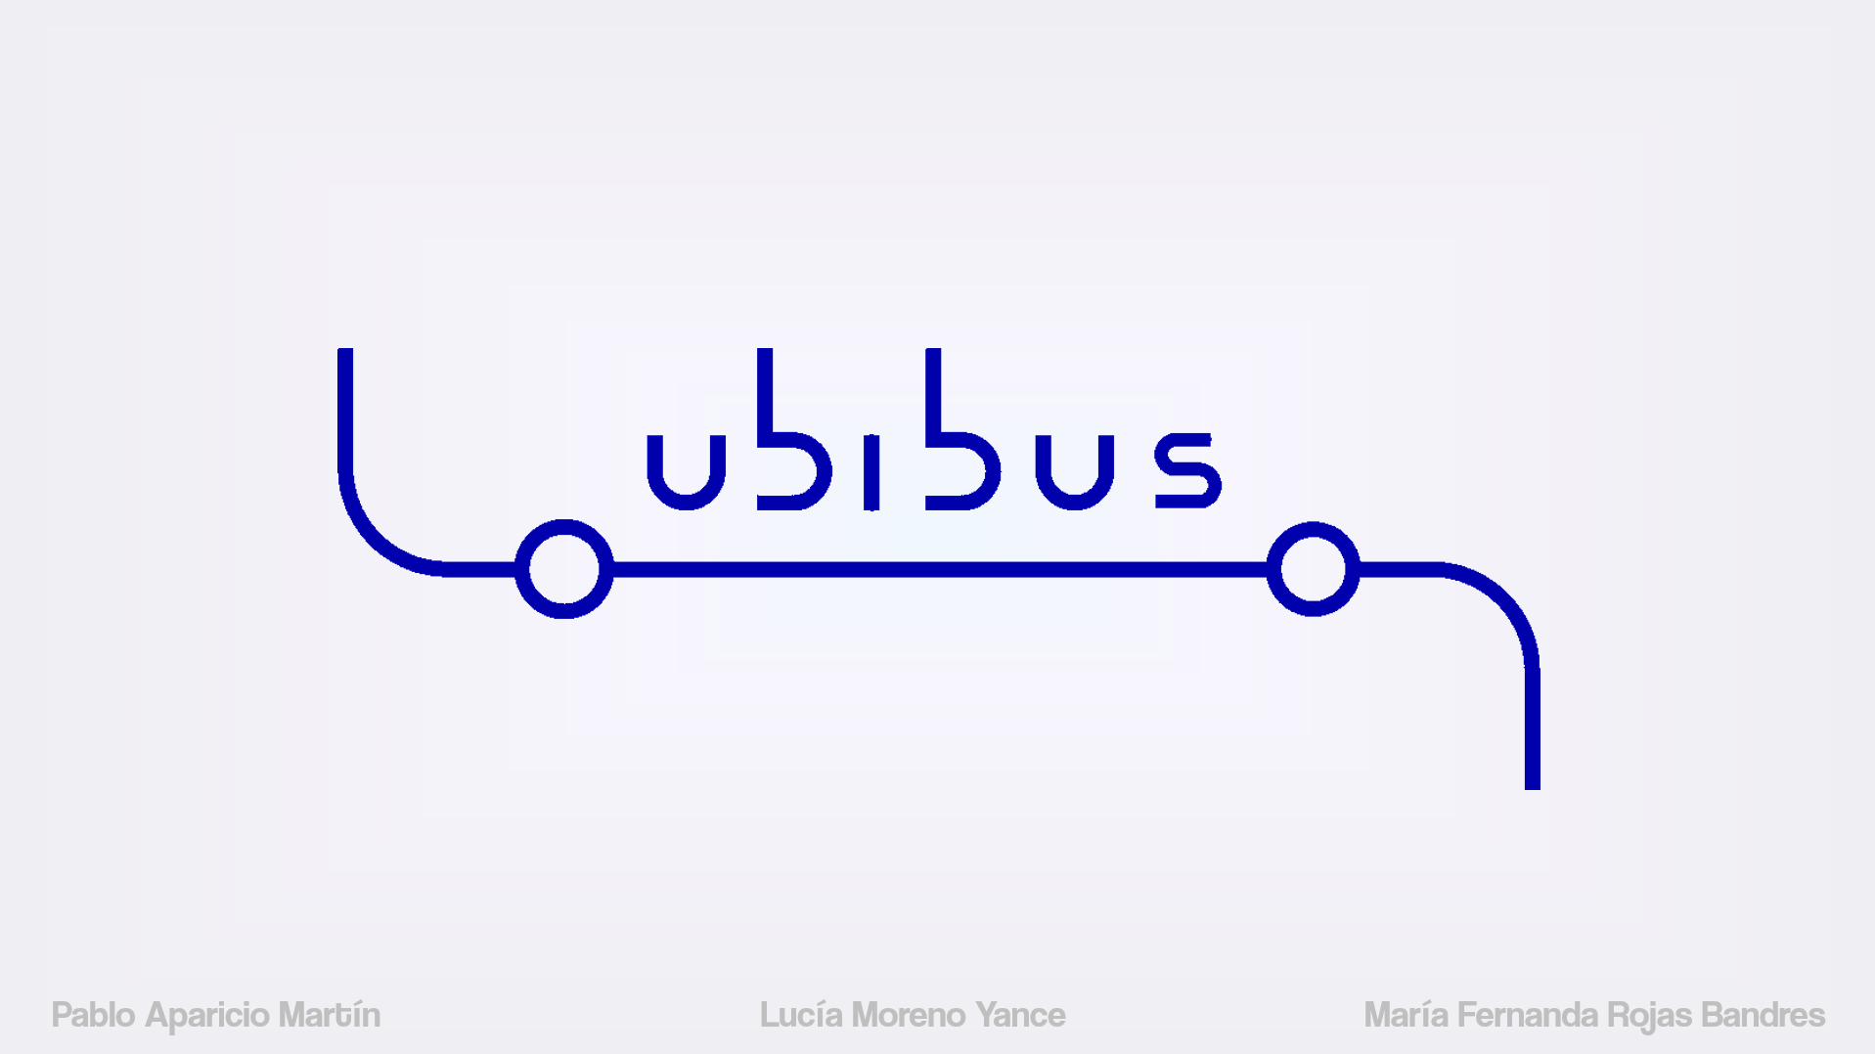
Pablo Aparicio Martín Lucía Moreno Yance María Fernanda Rojas Bandres
Notes:
Good morning everyone, my name is Lucía and I want to present you our Smart urban transport solution: ubibus
So Let's take a look at a key moment in public transport: the wait at the bus stop

Slide 4
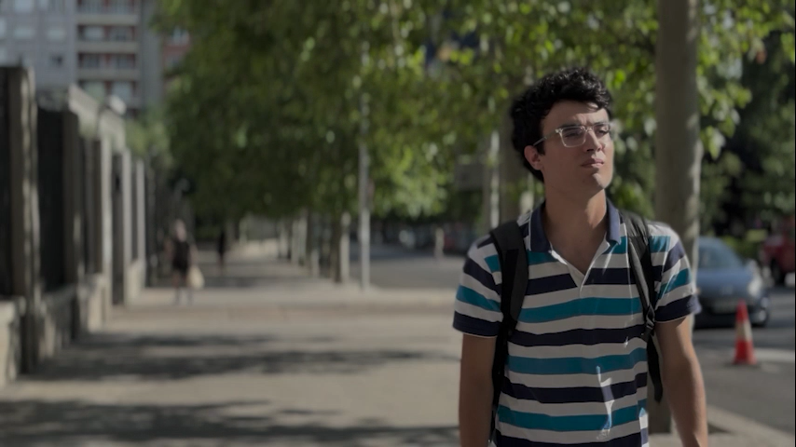
Problem
definition
Notes:
1:10 [Let's take a look at a key moment in public transport: the wait at the bus stop.]
Our user is Miguel, he is on his way to university to take an exam. Once he arrives at the stop, he checks the time and he has to wait 11 minutes for the bus to come. +++ After 8 minutes of waiting, he checks the time panel again and now it shows 9 minutes remaining. He feels completely frustrated. He doesn't know what has happened to the bus, how long it will actually take, or if it is really coming, because it could have been involved in a service disruption or accident. The way Miguel receives the information is not very empathetic and is not enough. +++He loses trust in the public system. So he thinks of an alternative and takes a private vehicle.++++++ This reality is even worse at night or in suburban areas with low-frequency routes.

Slide 5
User pain
points
Unreliability
Impossible planification
“It said 7 minutes, then suddenly 2. I ended up missing the bus. How am I supposed to plan around that?”
- Victoria, 48.
“…I wish I knew if it's coming at all…”
Frustration
-Laura, 24.
Notes:
\10s
Bus users complain: how am I supposed to plan around that?
"I wish I knew if it's coming at all"
--------------------------------------------------------------------------------------------------------------------------------
Our main user pain points are frustration, unreliability and impossible planification.
Losing a public transport user, driving more people toward private vehicles.
------------------------------------------------------------------------------------------------------------------------------------------------
So, which are the user pain points?
Frustration
Impossible planification
Unreliability
Inefficient transfers – many times, the bus is just a connection. And if you lose the bus, you lose the train.
Strong disappointment, leading to
Negative attitude towards public transport
And with all of these pains, we lose a public transport user, driving more people toward private vehicles.
---------------------------------------------------------------------------------------------------------------------------------------------------------------------------------------
Our goal is to reduce the user’s pain generated by the sparse and unreliable time information.
[If they knew the position of the bus, they could plan and take informed decisions/choose a different public mean of transport]

Slide 6

Notes:
The solution?: UBIBUS
Our product combines a paper information poster, similar to the already existing ones, with a vertical screen. This results on a smart display that still gives the crucial information in case of blackout
---------------------------------------------------------------------------------------------------------------------
(route name, stops, direction…).

Slide 7

Project overview
location
Status
time
what if bus stops communicate position and status of the next bus?
Notes:
We focus on bus location and status rather than just arrival times.
--------------------------------------------------------------------------
making the information easier to understand, more engaging and more reassuring for passengers.
It focuses on the concept of location and status instead of only the remaining time, resulting on a better comprehension by the user.

Slide 8
Attention!
Notes:
On the screen we have moving bus icons showing the real time position. With colorblind adapted color code for traffic state.
Blue is for normal traffic and red for congestion. (poner bus en rojo 2 segundos, y vuelve al azul)
We can communicate an issue by showing different icons or adding messages on the screen. (Poner mensaje de aviso)
(Mensaje de bus cancelado)
Also, if the service is cancelled due to an accident the bus turns to gray and then disappears. Something similar happens when the bus passes the current stop.
This info will also be digital, available scanning a qr.
Let's say Bus 1 and bus 2 are in congestede traffic, so we expect delays and we recommend using metro. And that is shown in a message in the vertical screen.
---------------------------------------------------------------------------------------------------------------------------------------------------------
On the screen we have a moving bus icon showing the real time position and the traffic state, with a colorblind adapted color code. We can communicate an issue on the bus line by showing different icons or by adding messages on the vertical screen. All of this powered by solar panels.
This info will also be digital (pasar), available in the smartphone scanning a qr or downloading the app.

Slide 9
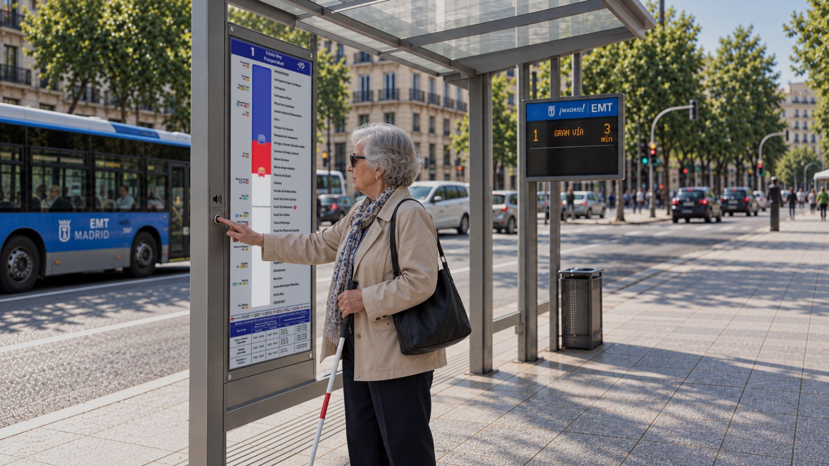
Notes:
For more inclusion, we also have a voice reading button for blind people.
------------------------------------------------------------------------------------------------------
UBIBUS provides innovation while keeping universal access, reaching every user.

Slide 10



Benchmark
Notes:
There are several apps that give time information and some even location.
But UBIBUS is not an app, is more than that. It's urban furniture with digital features, a physical product that provides real time information in the expected area: the bus stop. And at the same times users can make informed decisions from different places with the qr.
without needing a smartphone to complete its function.

Slide 11
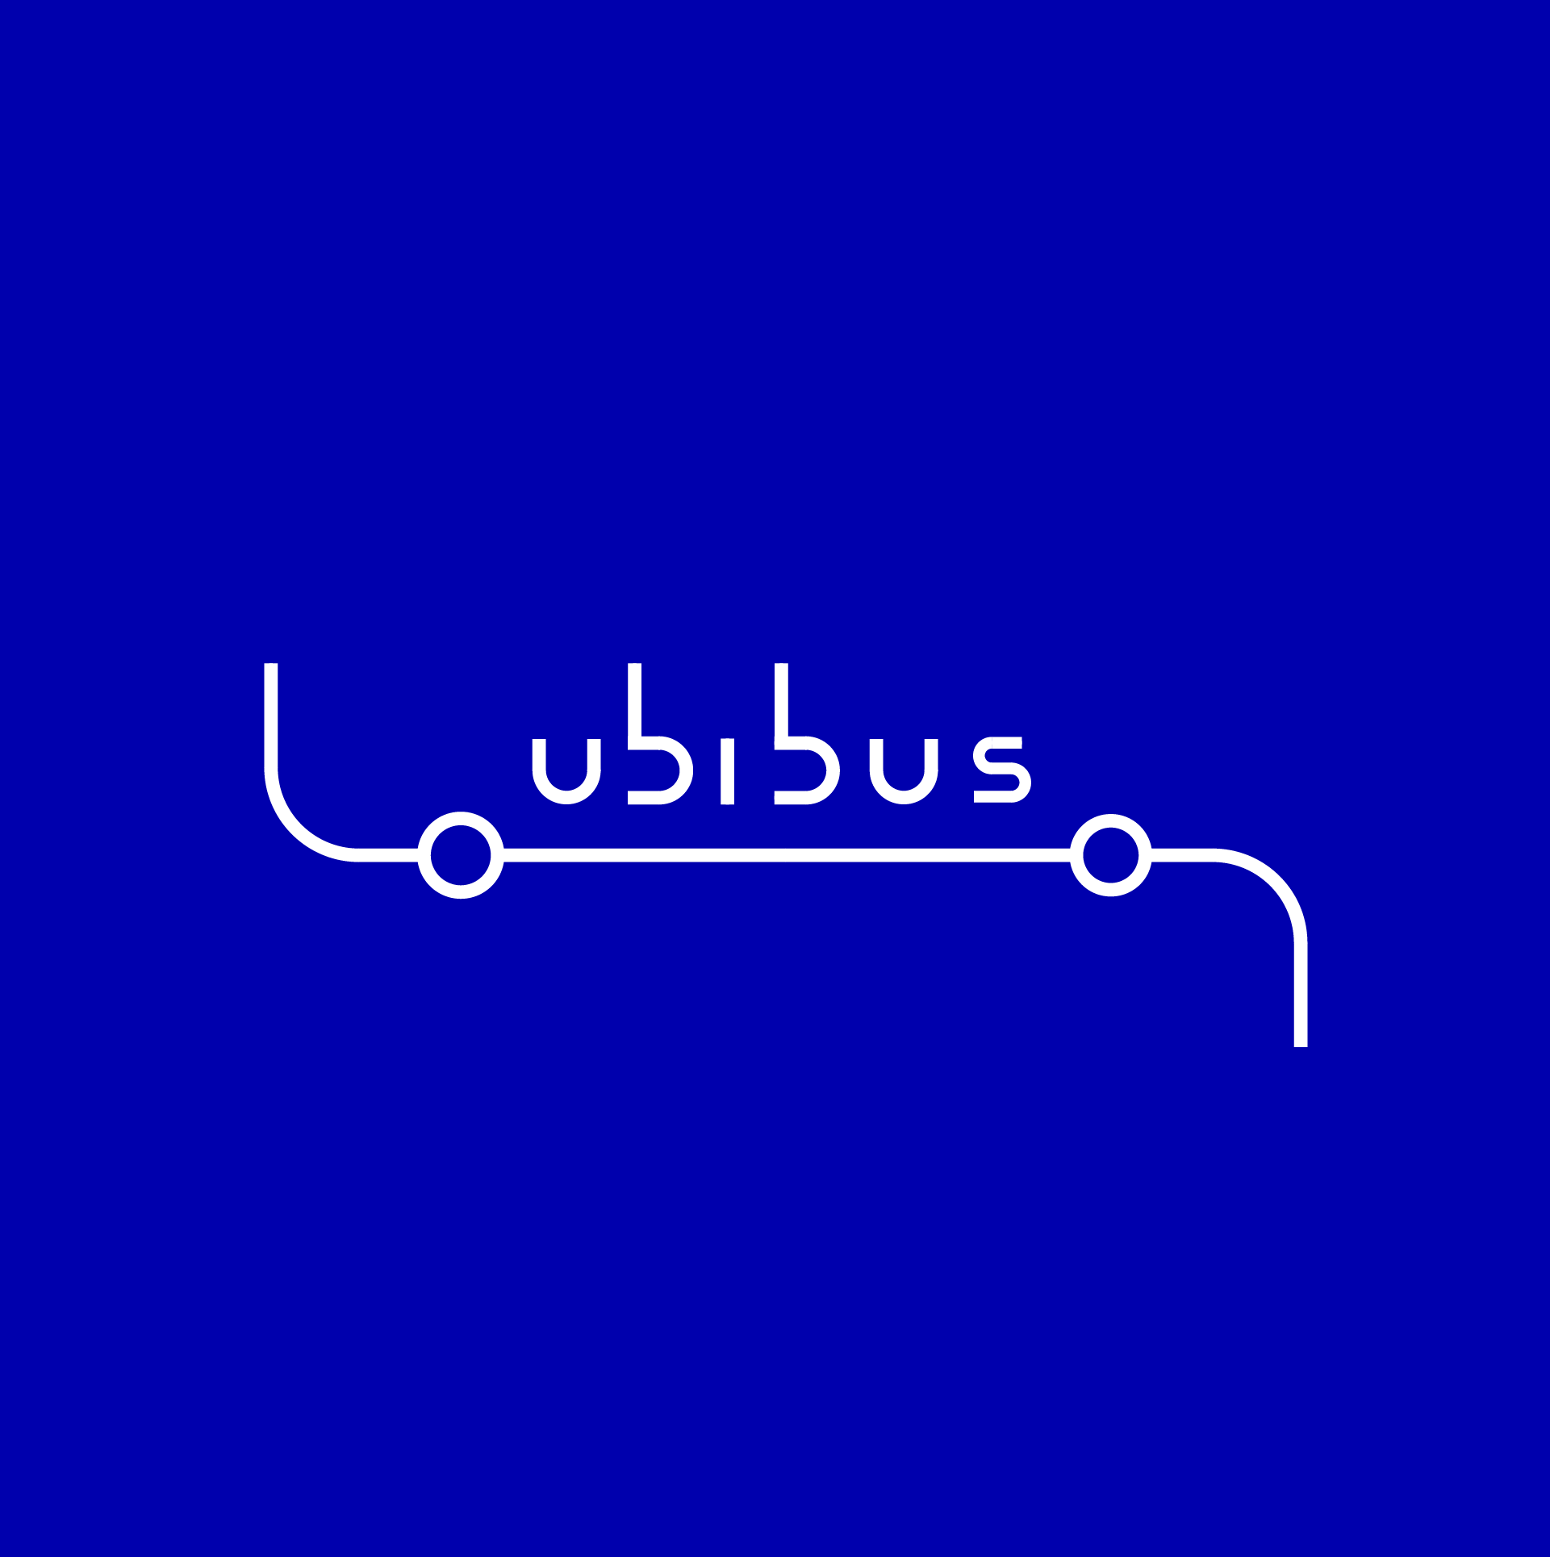
Benchmark
UBIBUS is not an app, is more than that. It's urban furniture with digital features
Notes:
There are several apps that give time information and some even location.
But UBIBUS is not an app, is more than that. It's urban furniture with digital features, a physical product that provides real time information in the expected area: the bus stop. And at the same time users can make informed decisions from different places with the qr.
without needing a smartphone to complete its function.

Slide 12
Community Impact
...overcomes daily obstacles
...is an affordable mobility solution
...encourages active mobility
...could reduce traffic
Notes:
10s
Ubibus values align with sustainable urban solutions. We overcome daily obstacles in an affordable way, encouraging active mobility and reducing congestion.

Slide 13
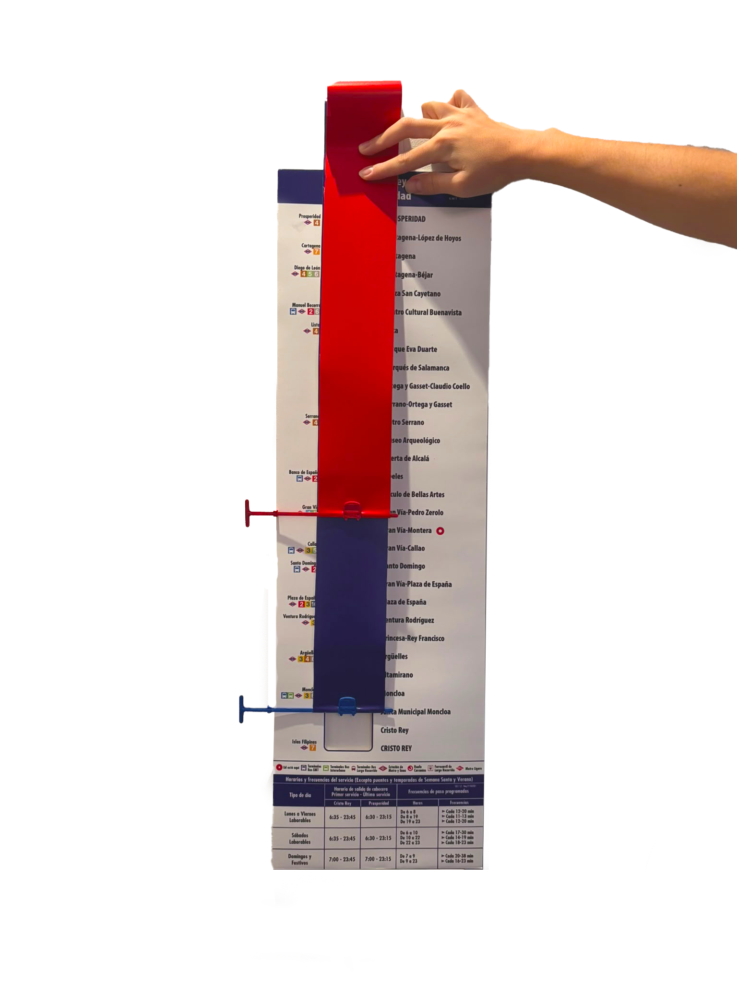
Progress
Software & hardware concepts
First functional prototype
Feedback from bus users from first functional prototype​
Notes:
From our first idea modelization in paper, to our first functional prototype with software and hardware.

Slide 14
Progress
“We really need something like this.”
Software & hardware concepts
-Kerstin, 37.
“That would be great! I'd finally know whether the bus is still coming or if I've already missed it.”
First functional prototype
Feedback from bus users from first functional prototype​
-Ray, 51.
Notes:
And thanks to that, real feedback from daily bus users.

Slide 15
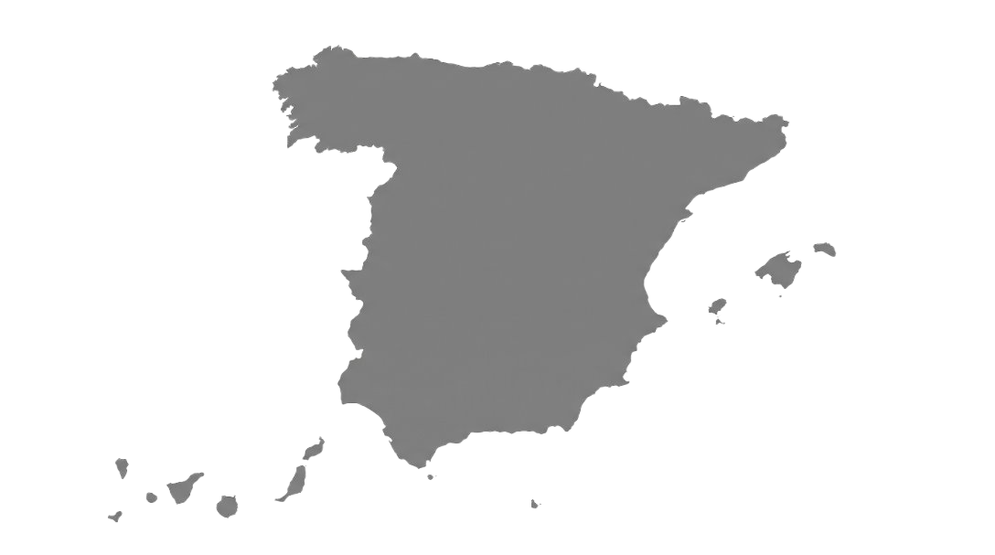
Business model
115
Urban transport companies
27
Intercity transport consortium
4
Main bus shelter suppliers
Notes:
But, how do we create a business from this?
By selling or renting UBIBUS units to any of the many possible customers identified in Spain.
----------------------------------------------------------------------------------------------------------------------------------------------
115 urban transport companies, 27 intercity transport consortium or 4 bus shelter suppliers from Spain.

Slide 16
Roadmap
Ford Smart Mobility Challenge grant
2026
2025
2027
2028
2029
2030
Increase presence in Spain
Further expansion abroad
Conceptual prototype
Functional prototype
Functional product
Busline in Spain
+
Positive Feedback
+
Geofencing
Notes:
Last year we made a conceptual prototype, now we are here in 2026, with our first functional prototype.
By the next year we will have a functional product, leading to the implementation in a complete bus line, increasing presence around Spain and then abroad.

Slide 17
Connected cities, informed citizens and strong public transport system.
More trust, more usage.

Slide 18
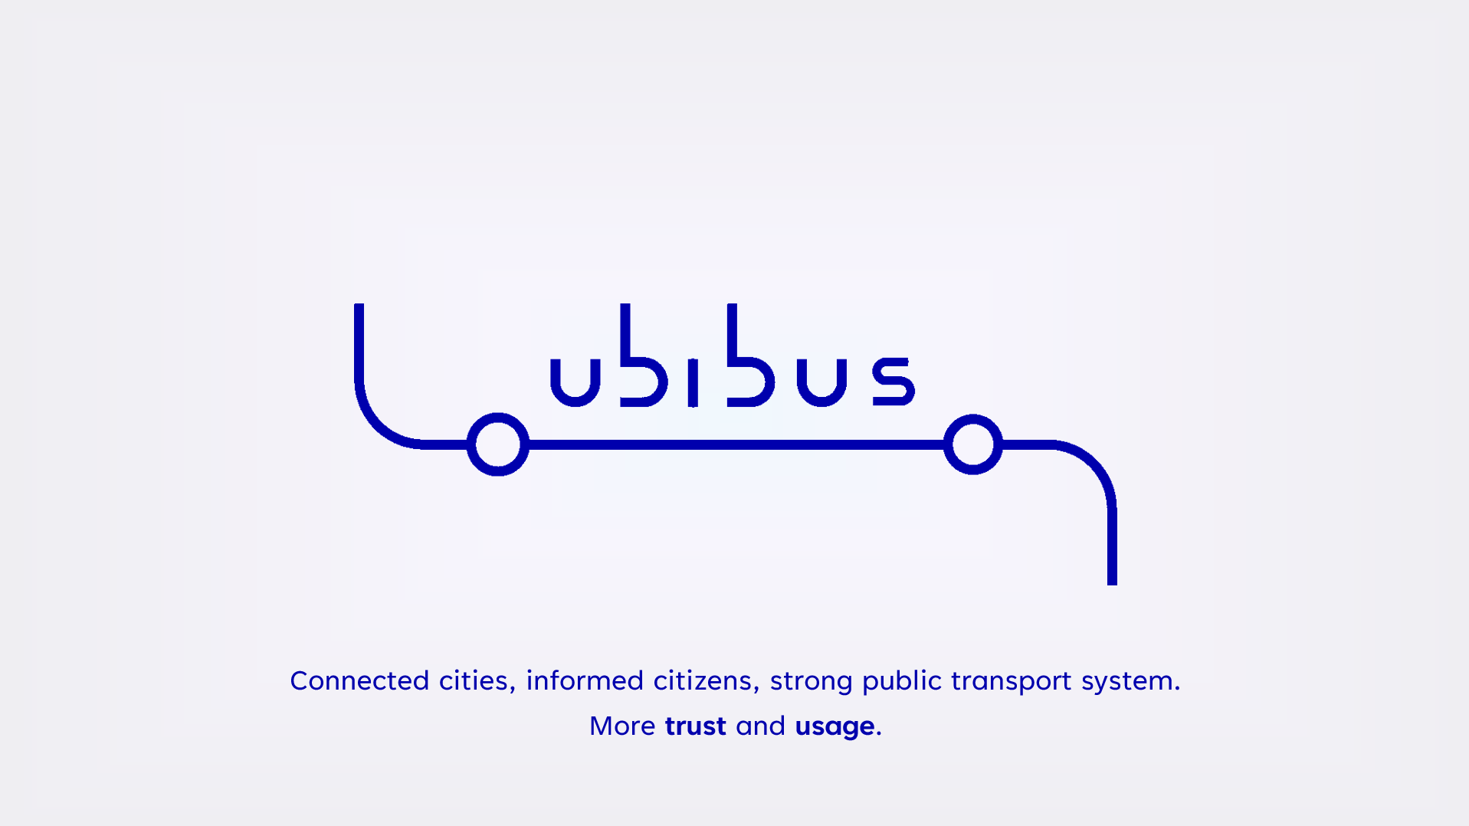
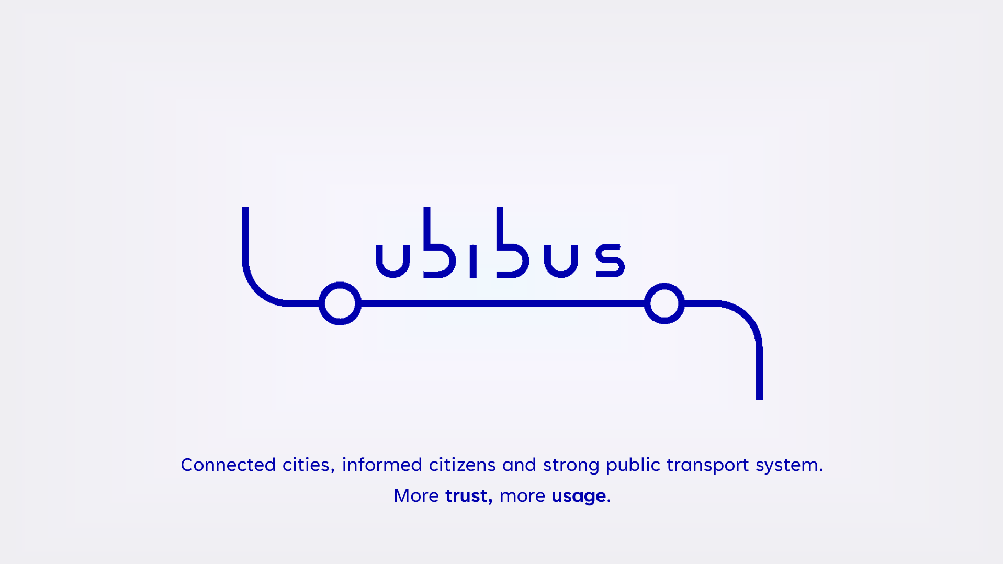
Connected cities, informed citizens, strong public transport system.
More trust and usage.

Slide 19
“It is necessary…”
-Kerstin, 36.
“That’d be great, then I know if it’s going to come or not.”
-Ray, 51.
“I wish I had that in my town.”
-José, 55.
Notes:
Last year we made a conceptual prototype, now we are here in 2026, with our first functional prototype.
By the next year we will have a functional product, leading to the implementation in a complete bus line, increasing presence around Spain and then abroad.

Slide 20
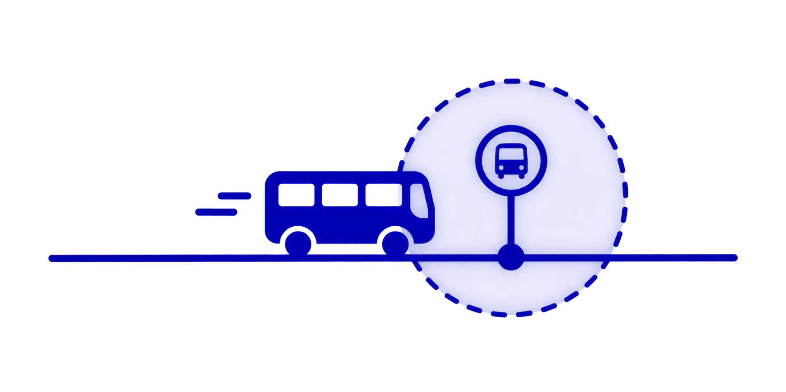
Scale-Up
Notes:
Ubibus can scale up by displaying more reliable data :
------
Queremos tener una base de datos poniendo sensors, y de esa forma ser independientes de cualquier compn de transporte.
Producir prototipos para una linea entera, q se tendrian q instalar en cada parada.
Ubibus focuses on displaying the information better, by showing data from EMT. As a scale up it can
Geofencing
Or sensors de cada parada

